Slide 1
IPv4

Slide 2
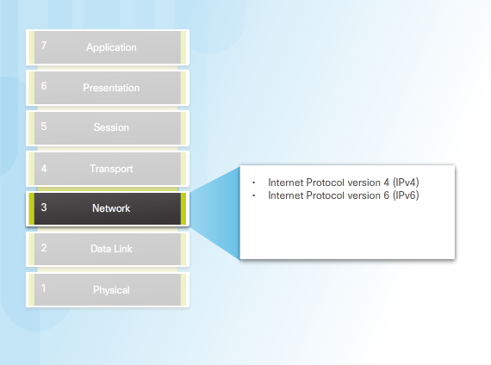
Network Layer Protocols

Slide 3
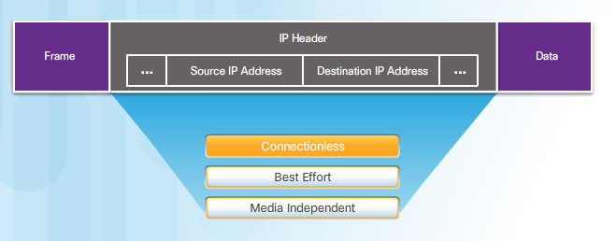
Characteristics of the IP protocol

Slide 4
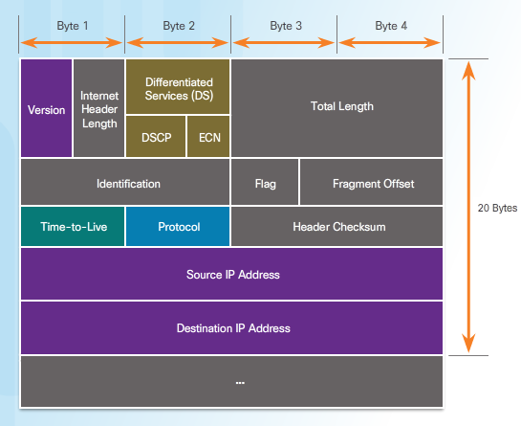
IPv4 Packet Header

